Slide 1
Chinese Antique Porcelain Shapes classifier
Done by: Hao Han
DSI30

Slide 2
Table of contents
Introduction
1
2
Data
Modelling
3
4
Conclusions
Background
Problem Statement
Shapes
Dataset
Modelling stages
Findings from modelling
Evaluation
Conclusions
Future works

Slide 3

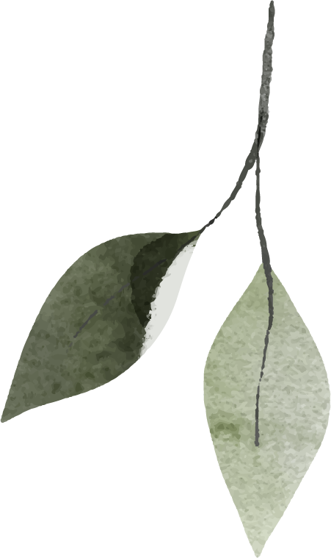
1
Introduction

Slide 4
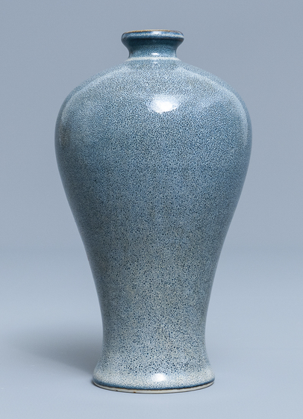
Chinese Antique Porcelain
Global auction sales of Chinese art and antiques reached $5.7 billion in 2019
The shapes of the porcelains also contribute to the beauty appreciation for Chinese antiques.
Modern vases are inspired by the classical timeless shapes of the antique porcelains.
瓷器

Slide 5
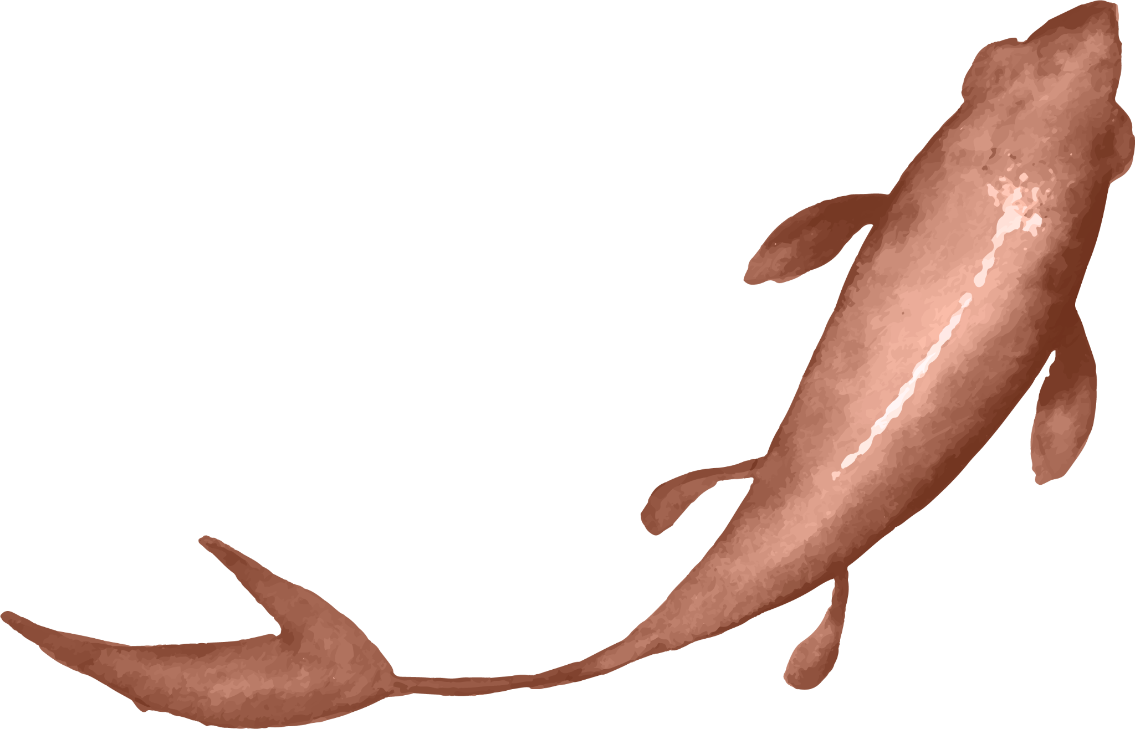
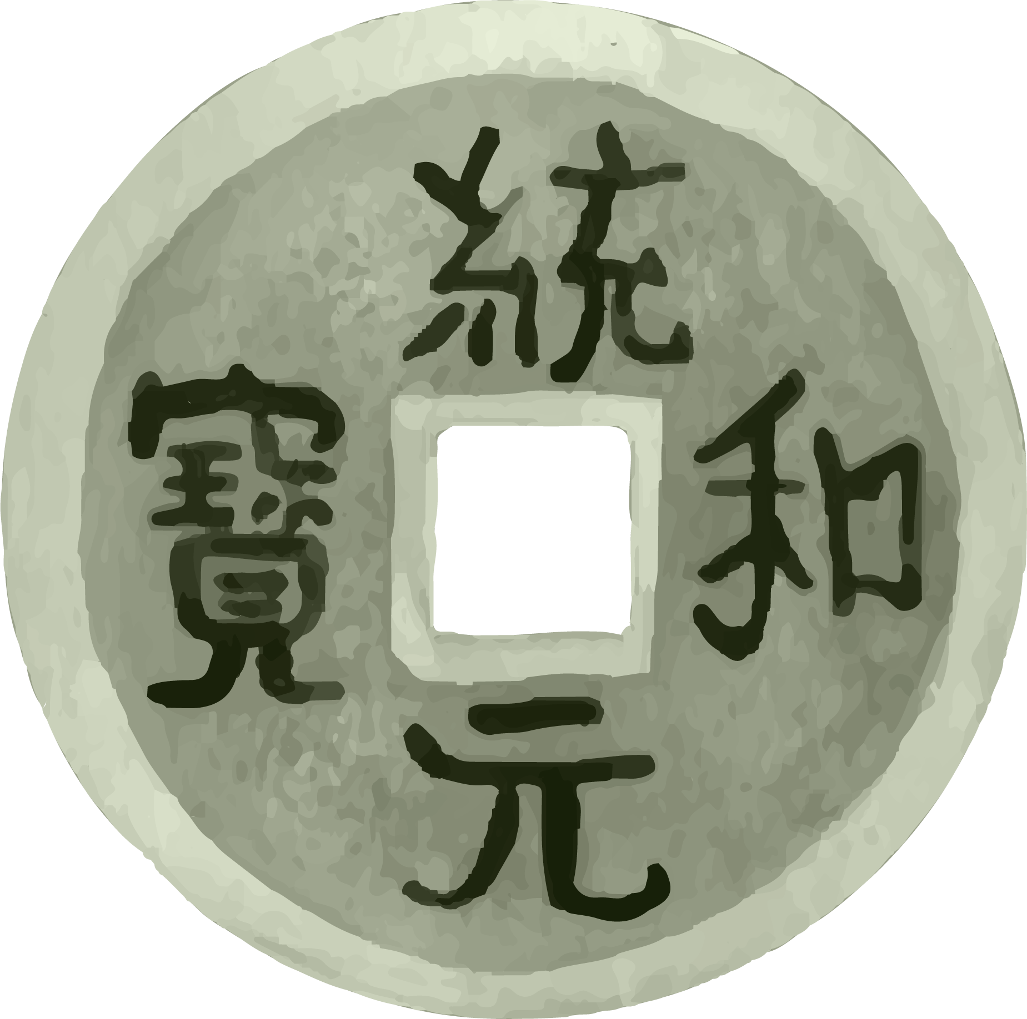
Problem Statement
Chinese antique collection is a very challenging and expensive activity.
To prevent overpaying for a porcelain or
buying a fake one
the collector will need to know the basics.
Shape of the porcelain is one of the fundamentals
to evaluate the antique authenticity and value.

Slide 6
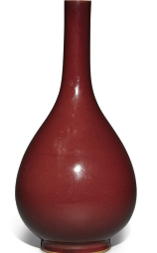
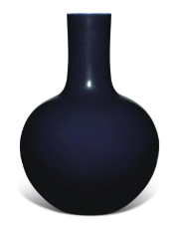
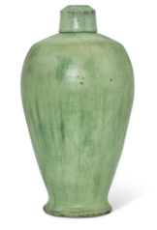
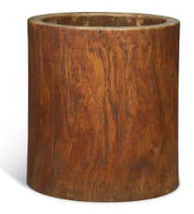
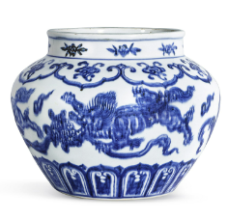
Data
2
数据

Slide 7
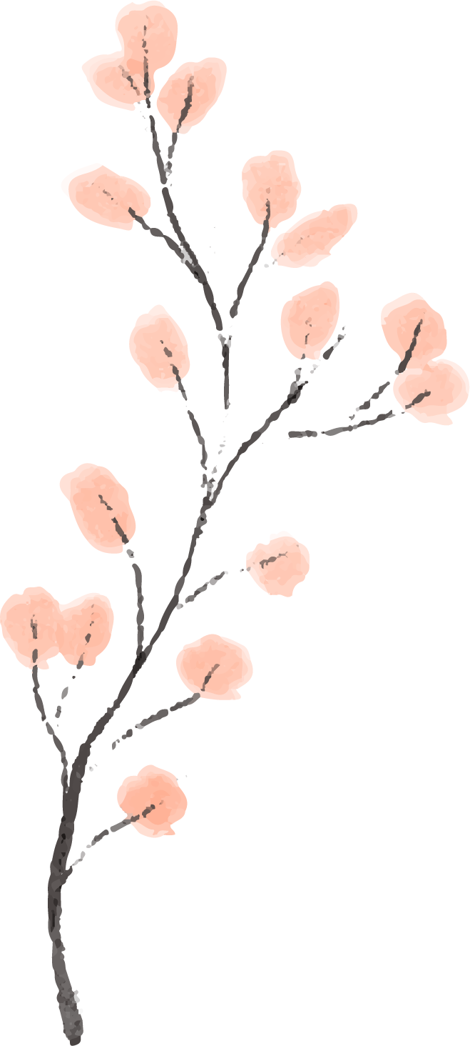
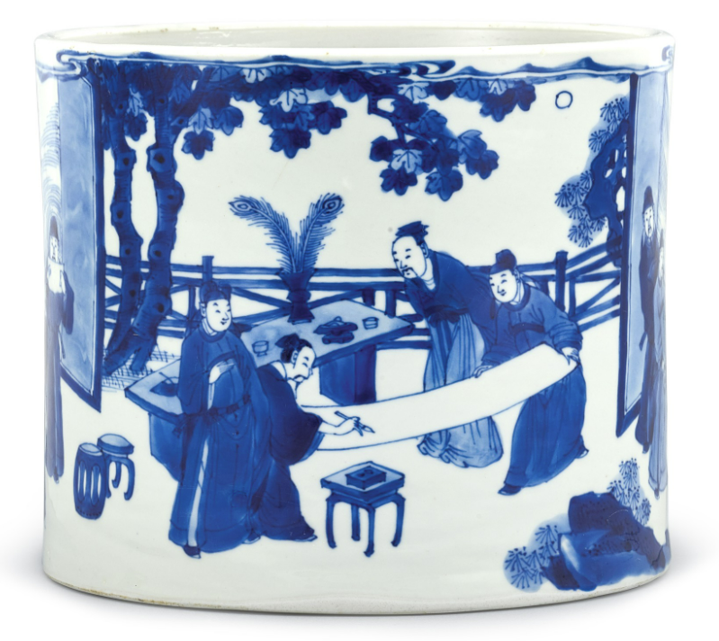
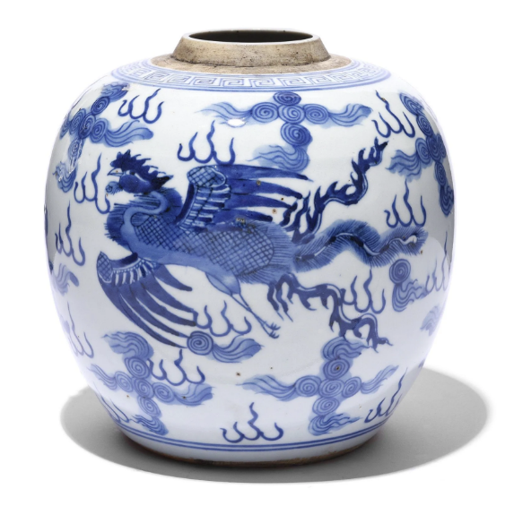
Porcelain Shapes
Brushpot
Jar

Slide 8
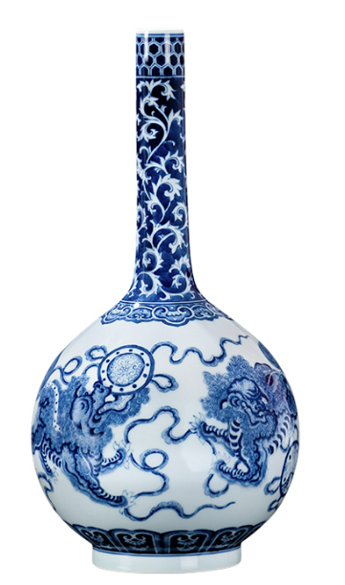
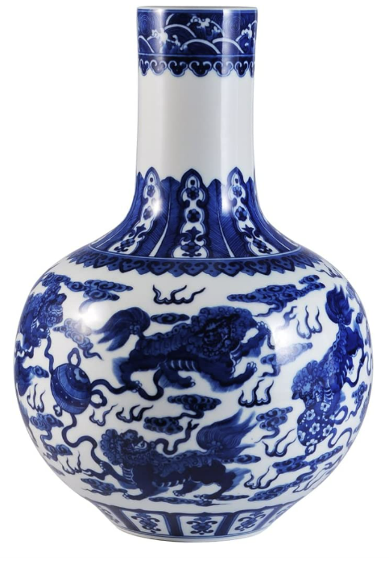
Porcelain Shapes
Tian qiu ping
Chang jing ping
(Globular vase)
(Long Neck vase)

Slide 9
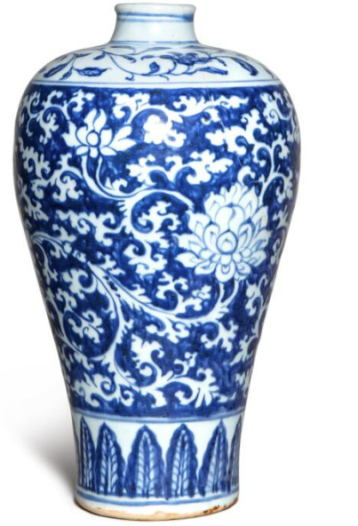

Porcelain Shapes
Meiping
(Plum vase)

Slide 10
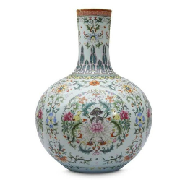
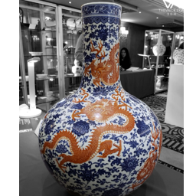
Dataset
Auction houses
Google images
Clean images with less noises
Example: Sotheby
Images with less resolution and more noise

Slide 11
Dataset
Brush pot
140
Long Neck vase
134
Jar
130
Plum vase
150
Globular vase
105

Slide 12
Dataset
Training
80 %
80 %
20 %
Test
Validation
20 %

Slide 13
Image augmentation
Rescale
Rotate
Zoom
Shift
Shear
Flip
Brightness
Fill

Slide 14
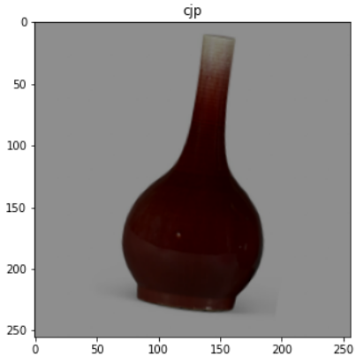
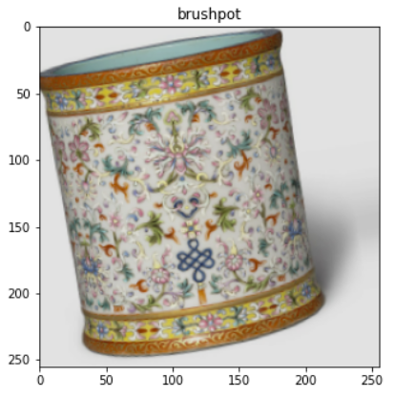
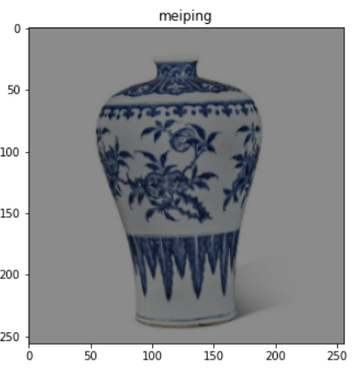
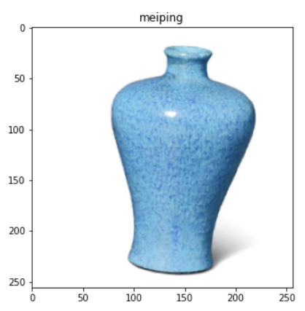
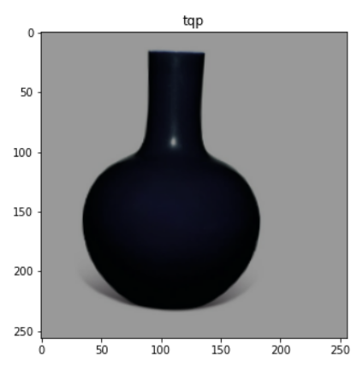
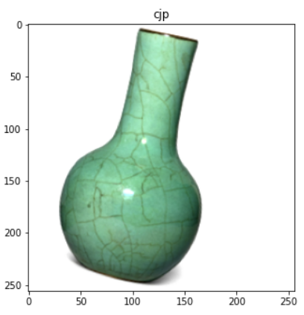
Image augmentation

Slide 15
Modelling
3

Slide 16
Modelling stages
Baseline
Transfer Learning
Fine tune
Manually adding layers
VGG19, MobileNetV2, Resnet50
Unfreeze layers, Reduce LR

Slide 17
2nd stage
3rd stage
Transfer Learning
Fine Tuning
Top layer - Not included
Freeze layers - ALL
Additional layers were added
Callback - Model Checkpoint
Learning rate is fixed
Top layer - Not included
Freeze layers – Top 10
Additional layers were added
Callback - Model Checkpoint, ReduceLROnPlateau
Learning rate is not fixed

Slide 18

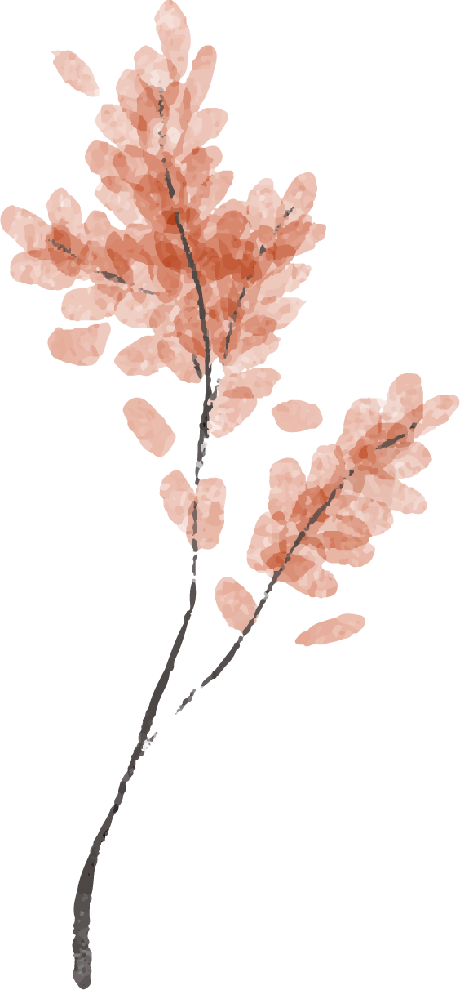
Model Comparison
Models | Accuracy
Baseline model | 47.7%
VGG19 | 84.8%
VGG19 (Fine tuned) | 86.4%
MobileNetV2 | 85.6%
MobileNetV2 (Fine tuned) | 85.6%
Resnet50 | 48.5%
Resnet50 (Fine Tuned) | 43.2%

Slide 19
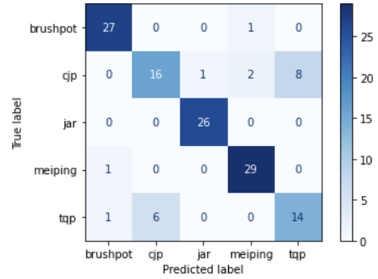
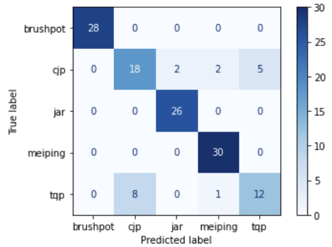
VGG 19
Fine tuned
VGG 19
Freeze layers: All layers
Freeze layers: Only the first 10
ReduceLROnPlateau
The learning rate was fixed at 0.001
The learning rate was reduced to 1.6000e-06
Accuracy: 84.8%
Accuracy: 86.4%

Slide 20



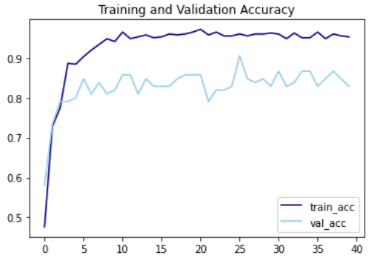
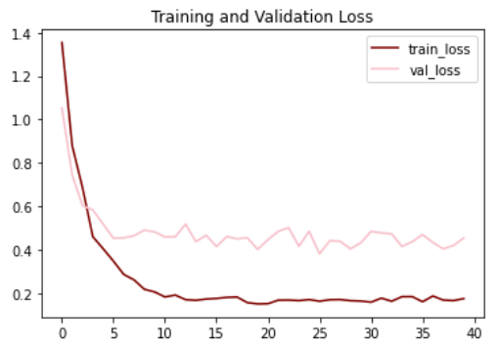
Plotting

Slide 21
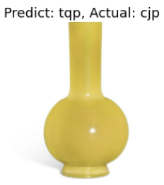
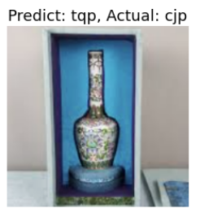
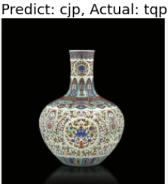
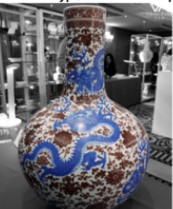
Misclassified images
Predict : TQP
Actual : CJP
Predict : CJP
Actual : TQP

Slide 22
Conclusions
4

Slide 23
Conclusions
Fine Tuned VGG19 - 86.4% > Baseline Model - 47.7%
Jar, Meiping and Brushpot classes were predicted perfectly.
The classifier can be used for new Chinese antique collectors interested in collecting brush pots, jars, plum vase, long neck vase and globular vase.
With the use of this classifier, the new collectors can get one of the basic right about their porcelain

Slide 24
Future work
To collect more data
Increase the number of classes to predict
Object detection
Dynasty classifier

Slide 25
Thanks!
Please keep this slide as attribution

Slide 26
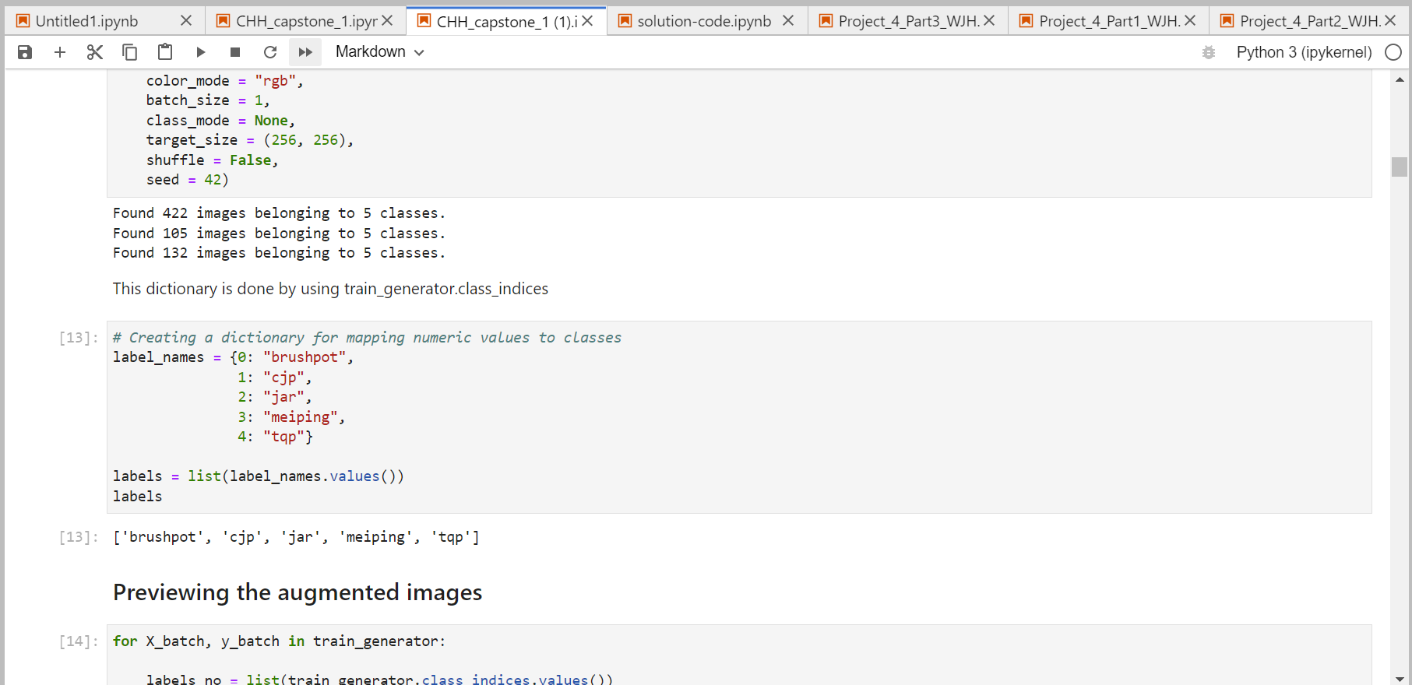
Struggles
Efficient net keep predicting 1 class
100% accuracy
Data collection

Slide 27
China icon pack

